Slide 1
PROCESS TERMINATION MESSAGES
TEAM MEMBERS:
K.V.KOUSHAL(2520030009)
Y.CHARAN SAI(2520030173)
B.SHASHANK(2520030452)

Slide 2
PROBLEM STATEMENT
In a Linux operating system, processes are created and terminated regularly, but it can be difficult for beginners to understand how and when a process terminates. It is also important to know whether a process completed normally or ended due to an error or signal. This project provides a simple way to create a child process, monitor its execution, and display a clear message about how the process terminated. It helps students understand process creation, parent-child relationships, process termination, synchronization, and exit status in Linux

Slide 3
OBJECTIVES
Create child processes using the fork() system call.
Monitor child processes until they complete execution.
Check the termination status of the child process.
Display clear messages for normal or abnormal termination.
Demonstrate parent-child relationships in Linux.
Demonstrate process synchronization using wait() or waitpid().
Understand process management using Linux system calls.

Slide 4
TECHNOLOGIES USED
TECHNOLOGY | PUROPOSE
C | Implement the process management program
LINUX/UBUNTU | DEVELOPMENT AND EXECUTION OF PROGRAMME
LINUX SYSTEM CALLS | CREATE WAIT AND TERMINATE THE PROCESS

Slide 5
TECHNOLOGIES USED
TECHNOLOGY | PUROPOSE
FLASK | Provides the backend and API for process monitoring
MYSQL | Stores process details and termination information
CSV FILE | Stores process creation and completion events

Slide 6
PROJECT COMPONENTS
COMPONENT | TASK WHICH IT PERFORMS
PARENT PROCESS | Controls and waits for child processes
CHILD PROCESS | Execute tasks and terminate
EVENT FILE(CSV) | Records process creation and completion events
FLASK | Processes event data and provides API
MY SQL | Stores process details and status

Slide 7
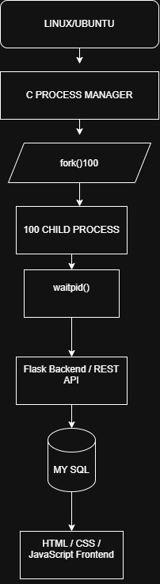

Slide 8
KEY FUNCTIONS
fork() → Creates child processes
waitpid() → Waits for child termination
exit() → Terminates a child process
getpid() → Gets process ID
sleep() → Simulates the execution time of a process.
fopen() → Opens the event file for reading or writing.

Slide 9
PROCESS EXECUTION FLOW
Start the C Process Manager – The process manager program begins execution.
Create child processes – The parent creates child processes using fork().
Execute tasks – Each child process performs its assigned task.
Terminate child – After completing its task, the child terminates using exit().
Wait for termination – The parent uses waitpid() to wait for and collect the child's termination status.
Record events – Process creation and completion information is recorded in the event file.
Backend processing – Flask reads and processes the recorded process information.
Database storage – Process details and status are stored in MySQL.
Dashboard display – The web dashboard retrieves the information and displays the current process status.

Slide 10
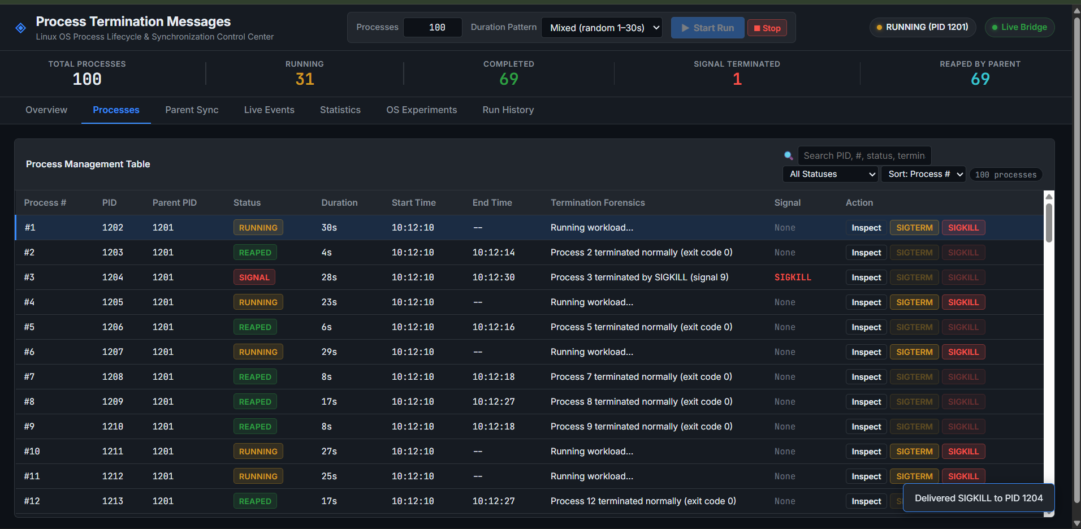
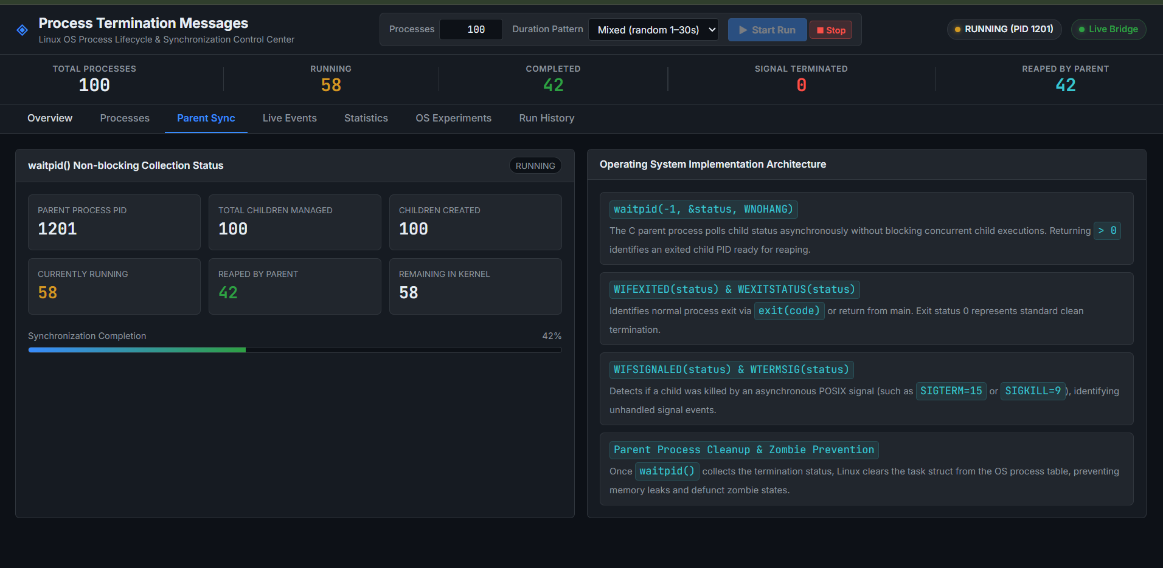

Slide 11
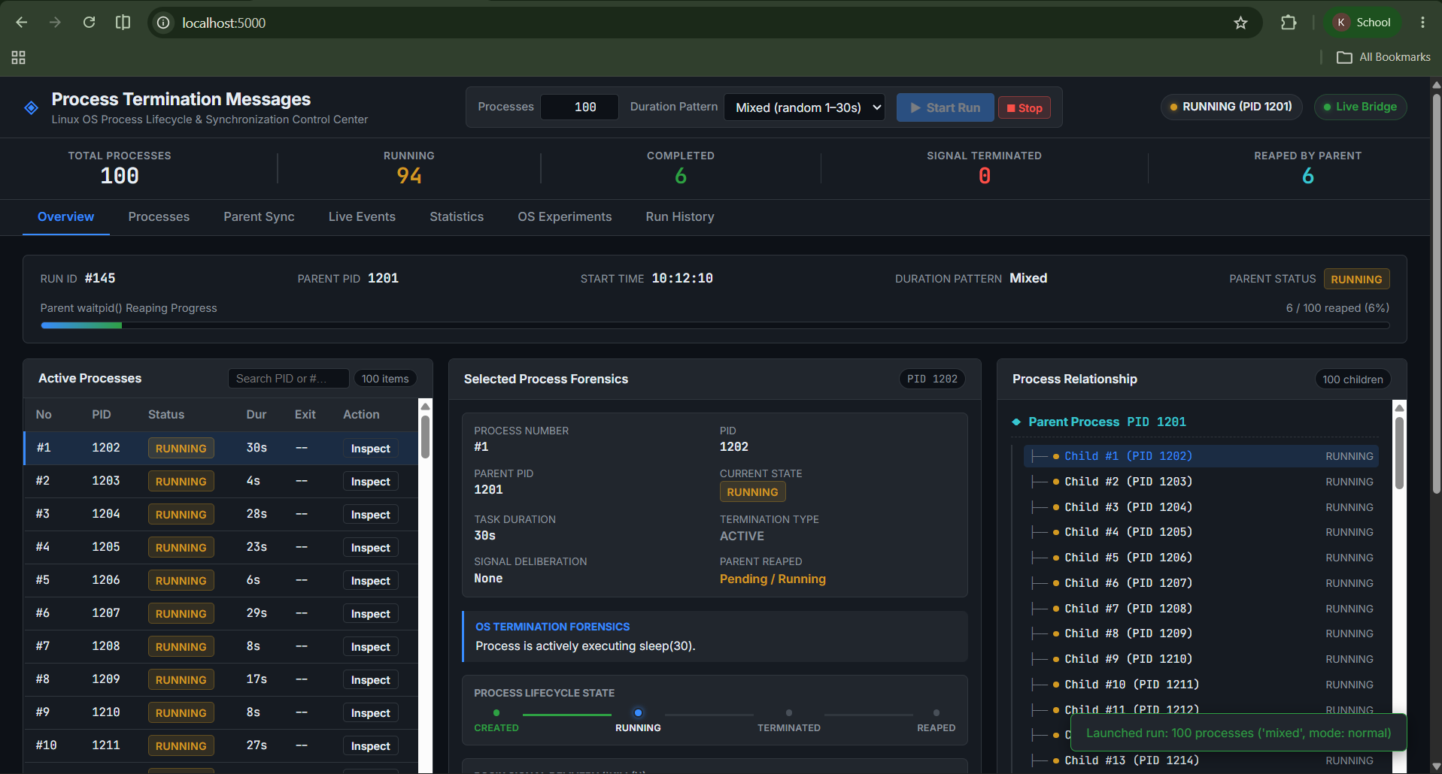
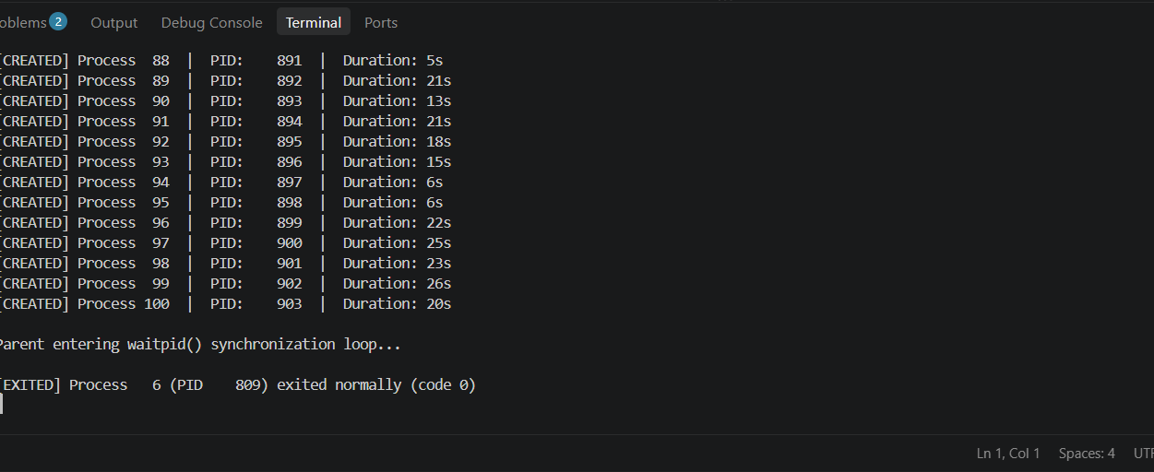

Slide 12
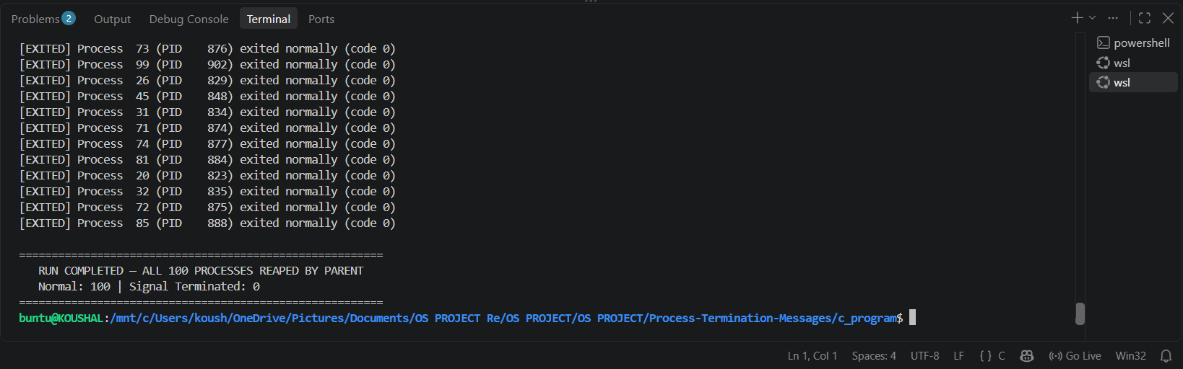
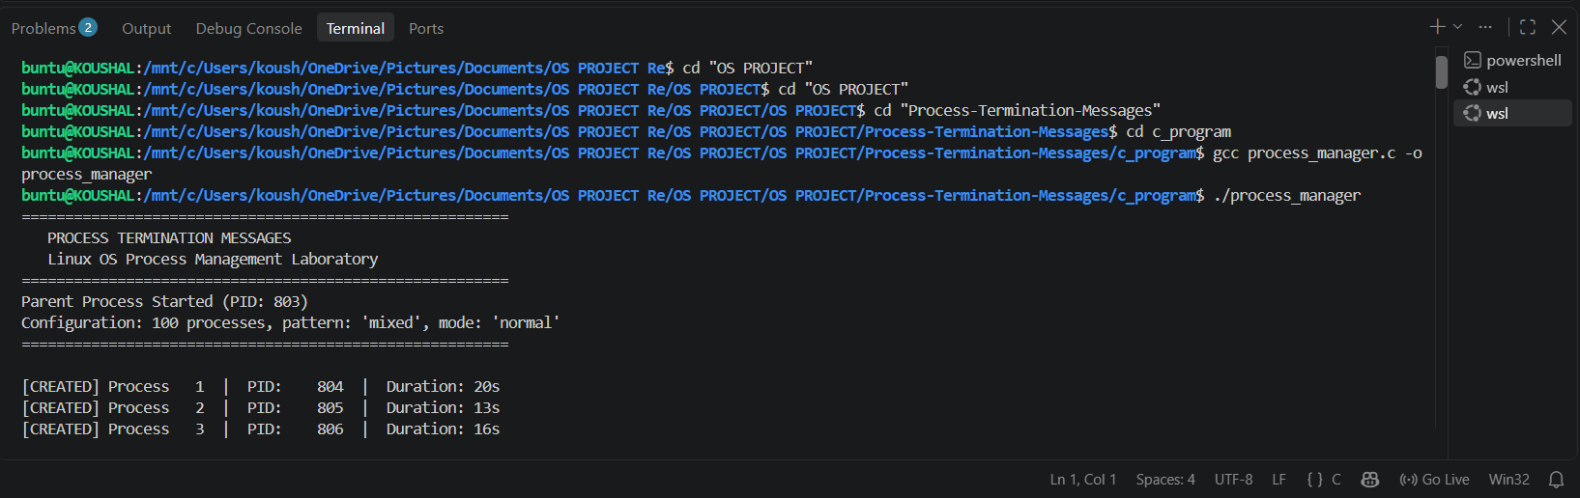

Slide 13
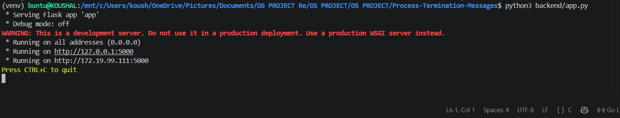
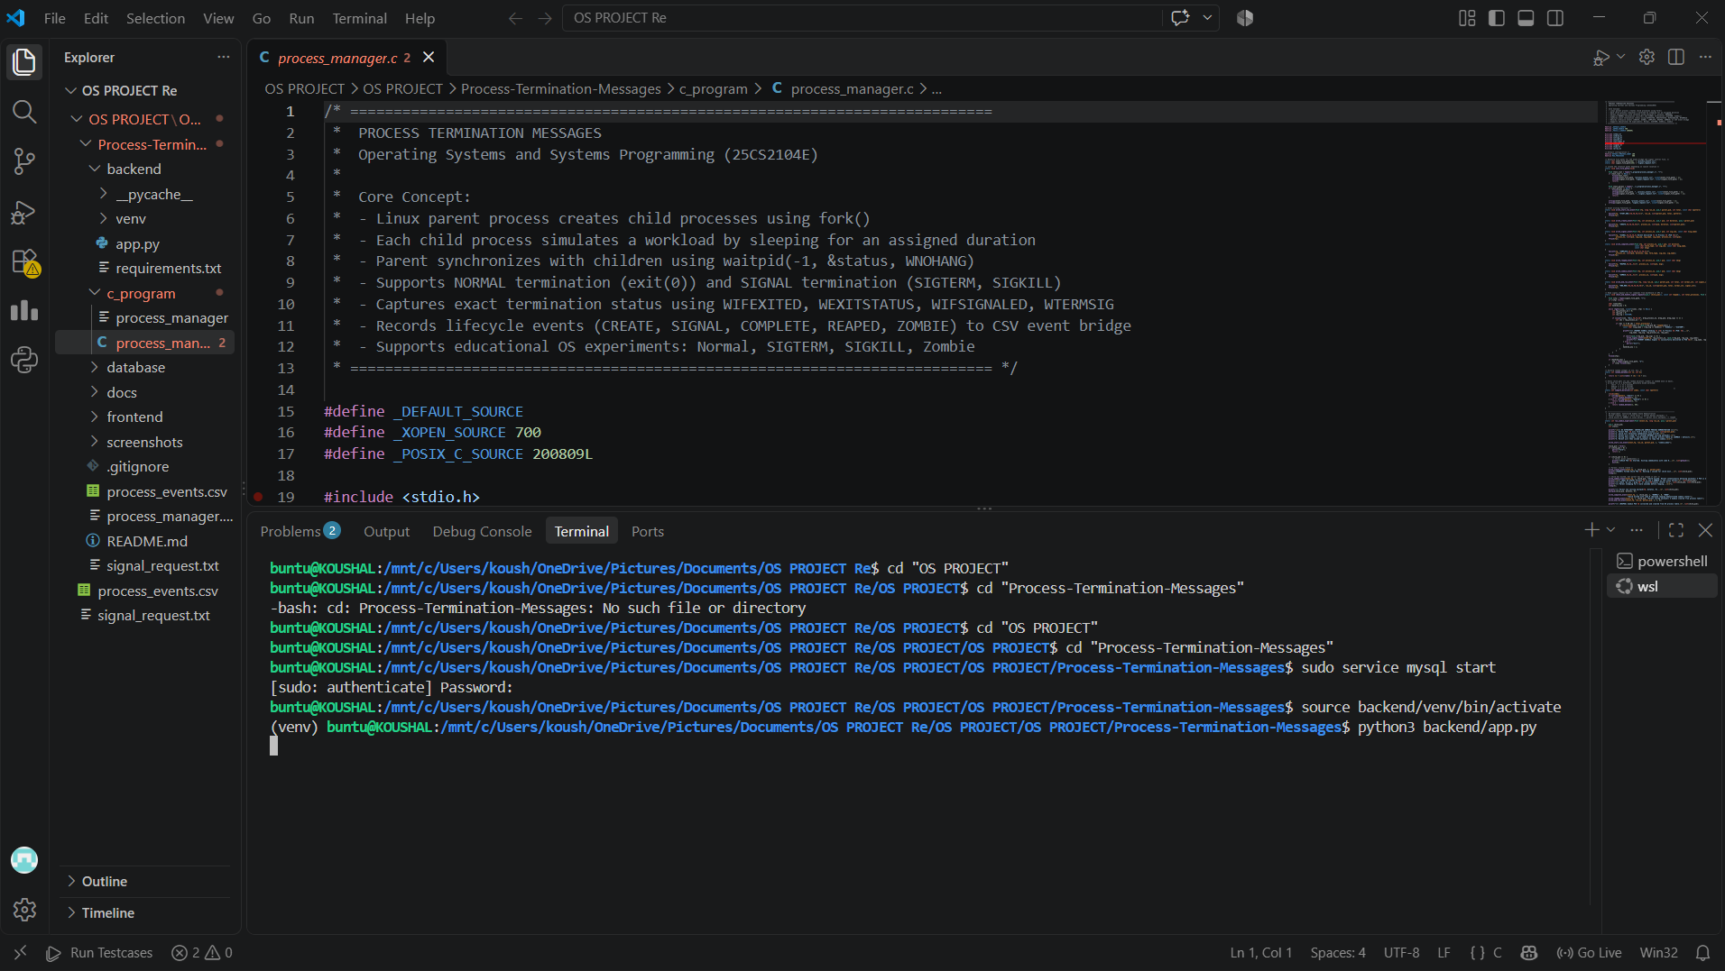

Slide 14
conclusion
Successfully demonstrates Linux process creation and termination.
Shows the parent–child relationship between processes.
Demonstrates process synchronization using waitpid().
Records process creation and completion events.
Displays the termination status and messages clearly.
Provides a simple way to monitor processes through the web dashboard.
Strengthens practical understanding of Linux process management and system programming.

